Slide 1
297D Final Project Big Data Management at Yelp
GROUP: DATA MINERS
Ansu Mathew
Muhammad Arsalan Ullah Khan

Slide 2

Project Question
Is there a pattern to monthly variations in the ratings of businesses? Comparing reviews to the average for that business, or each month to the prior month, do users rate businesses higher or lower than the average in certain months? Is this more of a seasonal or monthly issue? Does this vary geographically or by other sub-category?

Slide 3

WHY YELP WOULD WANT TO KNOW?
Increasing Engagement: By looking into the variations of ratings and reviews between businesses, Yelp will be able to provide businesses with an improved platform that would help them engage more with consumers.
Expanding our reach through advertising: The difference in ratings between businesses would also be likely due to certain businesses not able to find an appropriate means to reach the purchase intent driven customers. Therefore, improving on the promotion offers, targeted search advertising, discounted offers and further enhancements to their business listings page could help them engage more with consumers, thereby increasing revenue from advertising.
Provide a great consumer experience: Another possibility behind looking into the question on if users rate businesses lower or higher, could be to find out the possibility of Yelp’s users experiencing a negative user experience. Therefore, by not using solutions that could alienate users or degrade the user experience, Yelp could provide more on consumer protection. This way Yelp would be able to offer a high user experience which would result in more users engaging with their platform.
Therefore, increases in the metrics like ratings and review count, would help to improve the value proposition of Yelp to local businesses as they seek easy to use and effective advertising solutions.

Slide 4
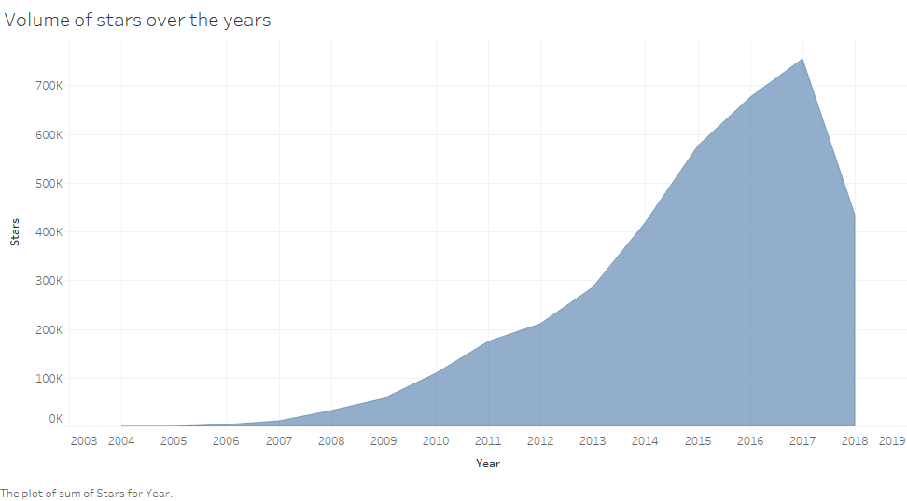
Volume of ratings given each year at Yelp for the 5 categories considered. Clearly there wasn’t enough data in the initial years but the slope changes from 2009 onwards

Slide 5

Decisions
Used only businesses with review count less than 10
Deciding to select 5 top level categories based on the YelpInc_10 K file based on the categories that received highest reviews by users.
The star rating provided in business dataset is the average star which is rounded to half star increment. Hence to get a more fine grained calculation of the average, the average of review_ids for each businesses were calculated and then compared to the rating for each reviews.
Ignoring records that showed up as ‘NULL’ for the selected 5 categories

Slide 6
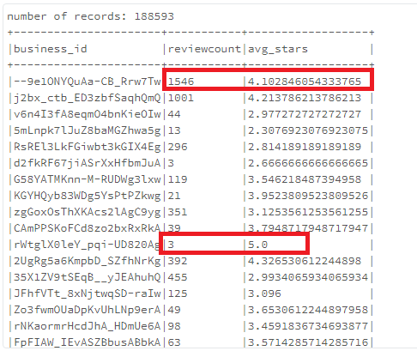
Issues with using all data
Business with 1546 reviews but average rating is 4.102
Business with 3 reviews but average rating is 5.0
This does not make sense. We’ve thus chosen to limit our dataset to businesses who have 10+ reviews

Slide 7
Filtering the data based on # of Reviews
Context | Number of Reviews
Total number of reviews for the 5 categories we chose | 5996996
Limiting businesses to +10 reviews only | 5457875
There were 539121 records that were eliminated.
Hence, the team chose to only analyze businesses with +10 reviews.
We did not want to set it at a higher range since we assume we would lose data that could impact our analysis

Slide 8

Filtering for a dataset of 10+ reviews As is observed, filtering altered the average star rating across each category, with almost all of them seeing a rise.
Category | Rating Before filtering | Rating after filtering
Restaurant | 3.71 | 3.72
Shopping | 3.75 | 3.79
Home Services | 3.80 | 3.86
Arts & Entertainment | 3.58 | 3.57
Night Life | 3.68 | 3.69

Slide 9

Comparing reviews to the average of businesses to check where review count>10

Slide 10
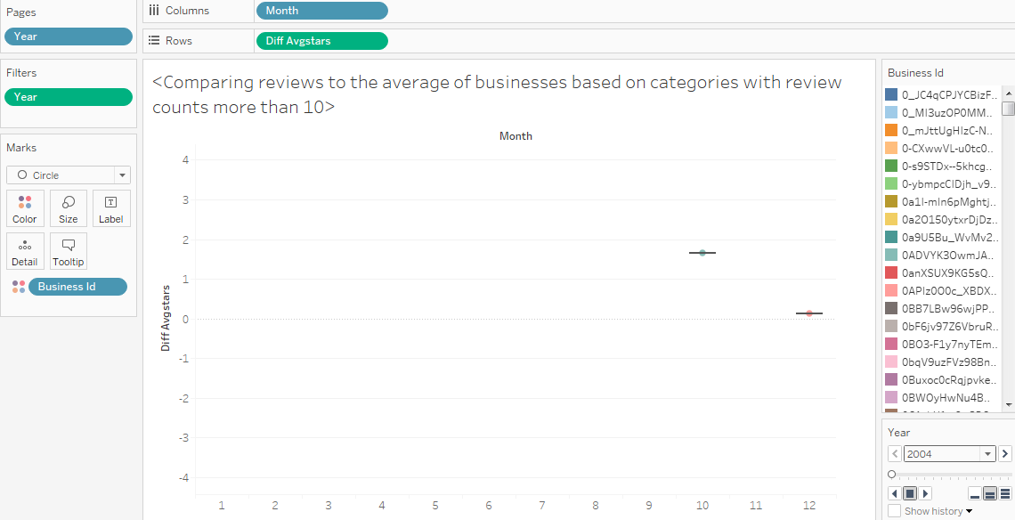
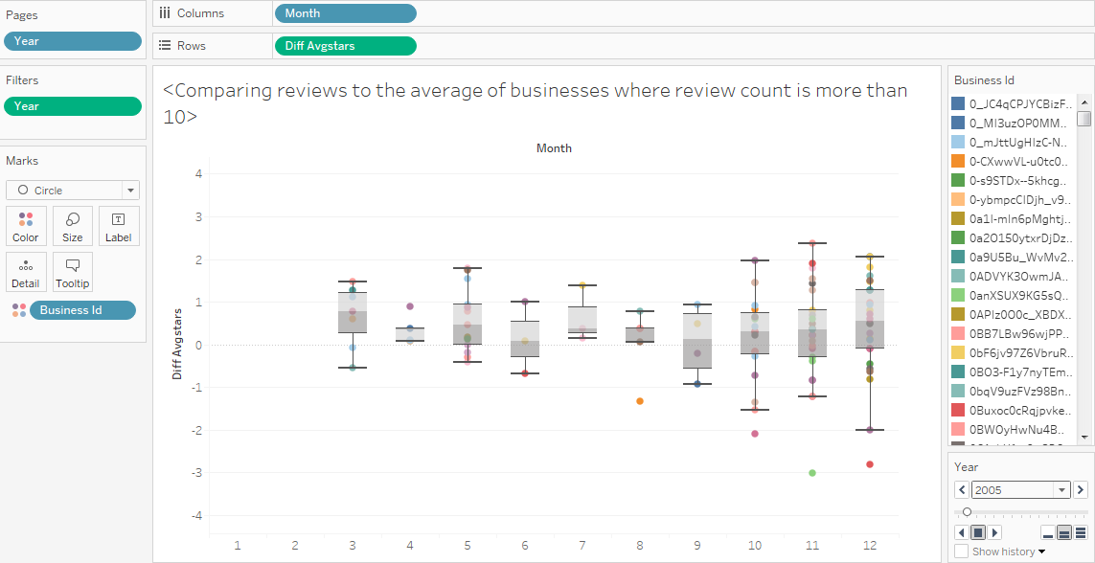
Hardly any data to compare over initial 2 years, but we do note that whoever did rate, rated higher than the average

Slide 11
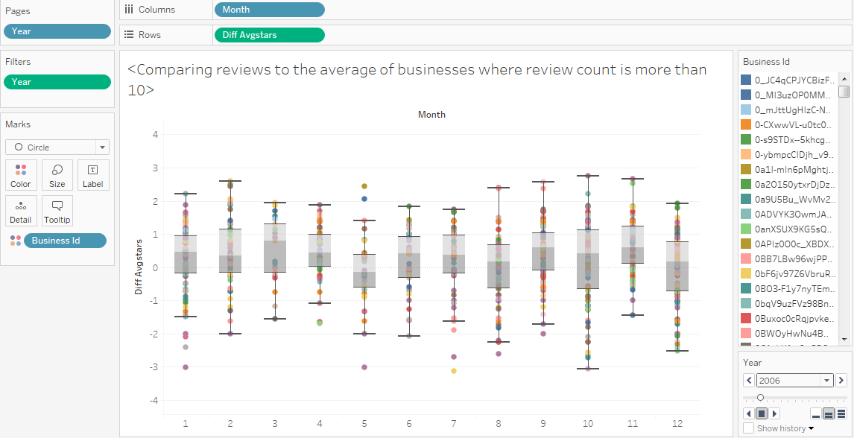
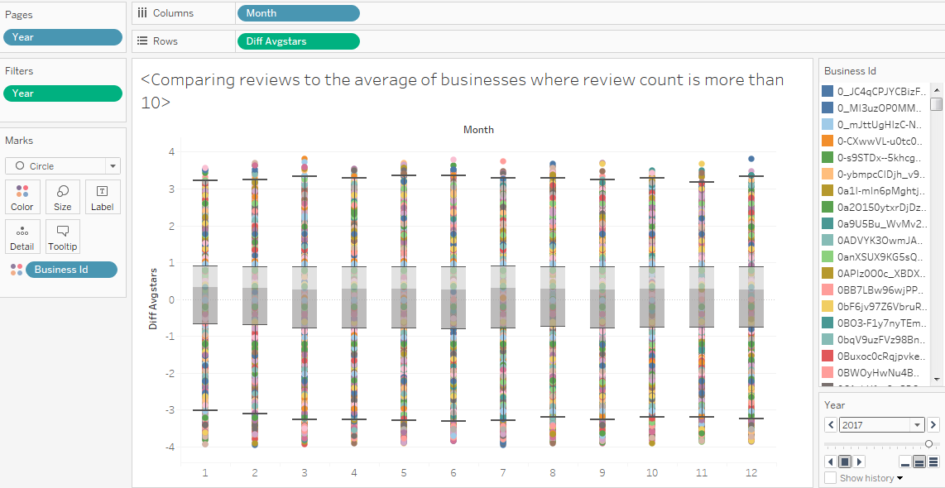
2006 vs 2017 Any pattern that was observed in the earlier years, is not seen anymore. Even though users still rate businesses higher than the average, there is no pattern to it over the months

Slide 12
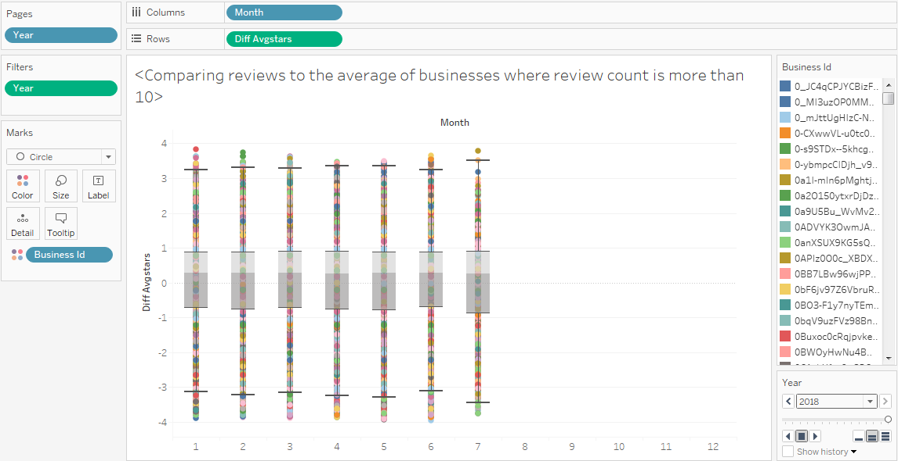
2018 follows the trend of recent years; users do rate slightly higher than average but no real trend in any month

Slide 13
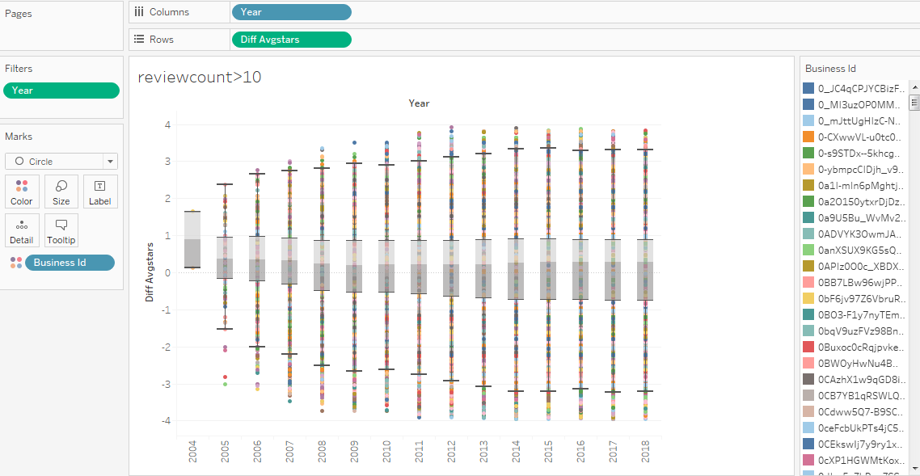
The median values for every year is higher than the average rating of the category

Slide 14
Comparing reviews to the average of businesses to check if varies by Categories and geographically where review count > 10

Slide 15


Category: Restaurants

Slide 16
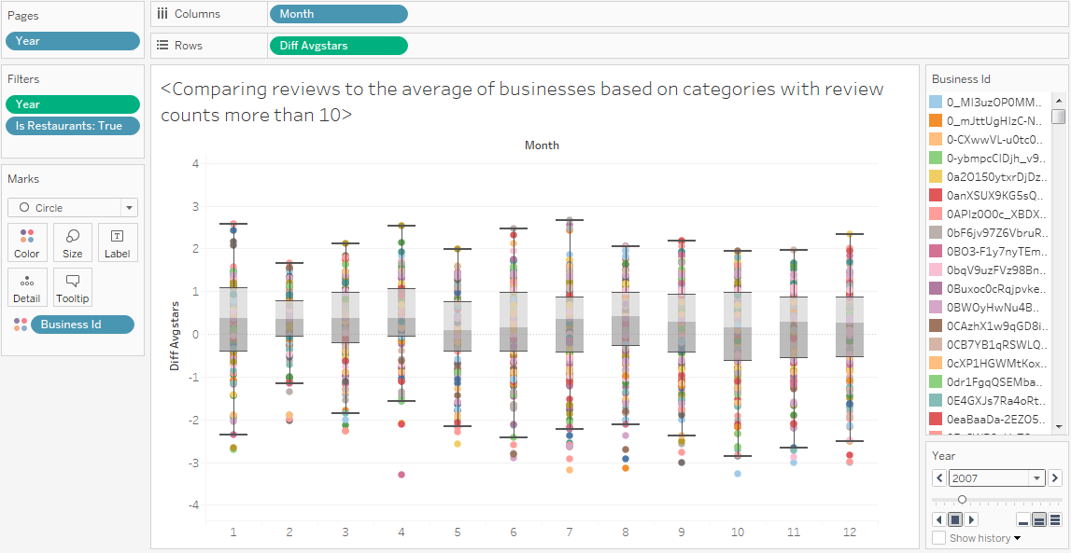
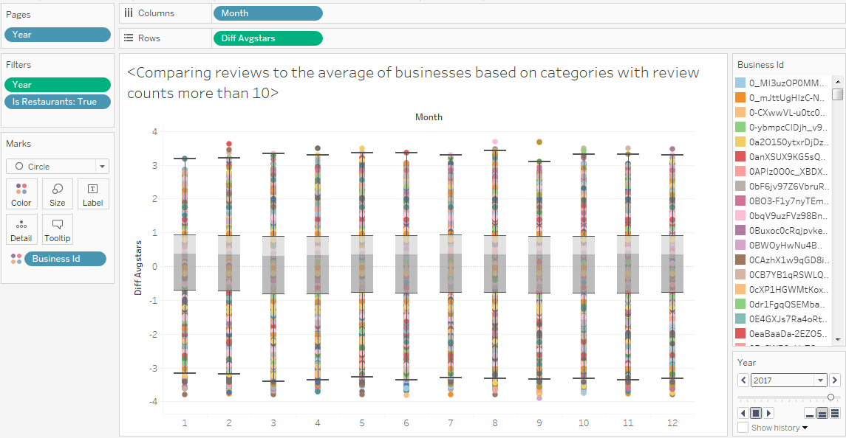
Comparison over months for 2007 vs 2017 Users rate businesses higher than the average, but no monthly pattern observed of late

Slide 17
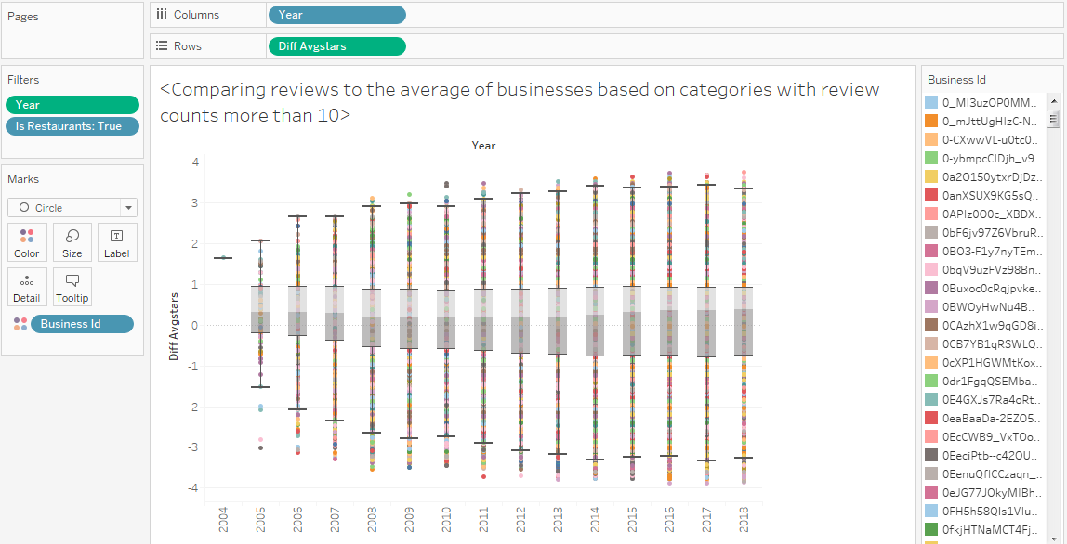
For Restaurants, most users rate higher than the average but no observable trend

Slide 18
Category: Shopping

Slide 19
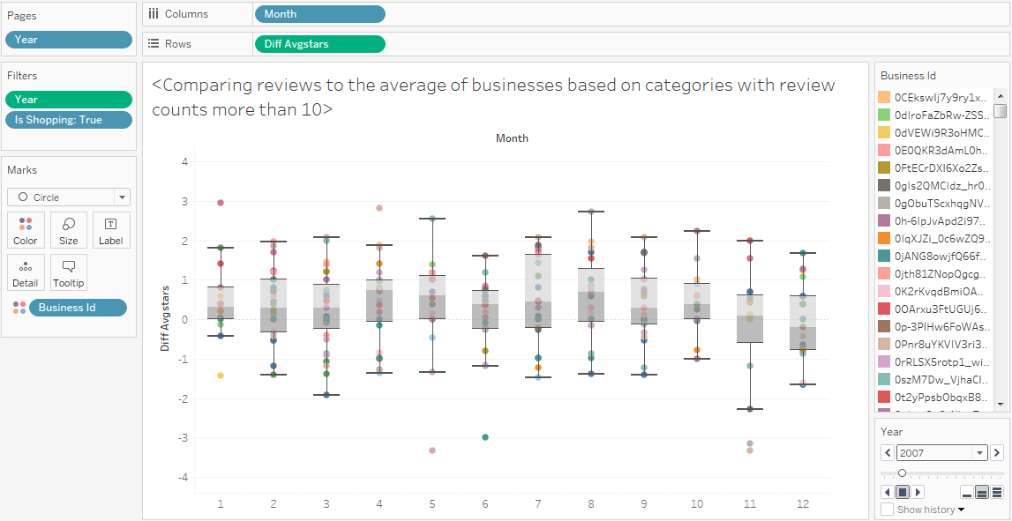
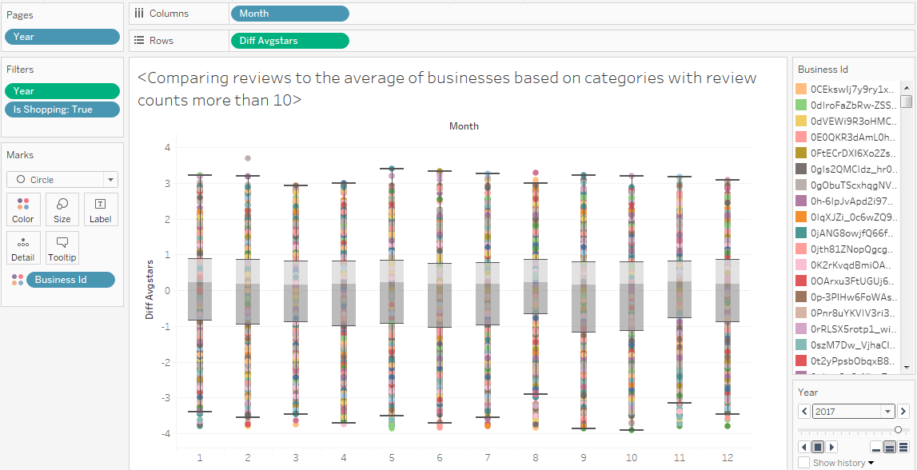
Comparison over months for 2007 vs 2017 Users rate businesses slightly higher than the average, but no monthly trend observed

Slide 20
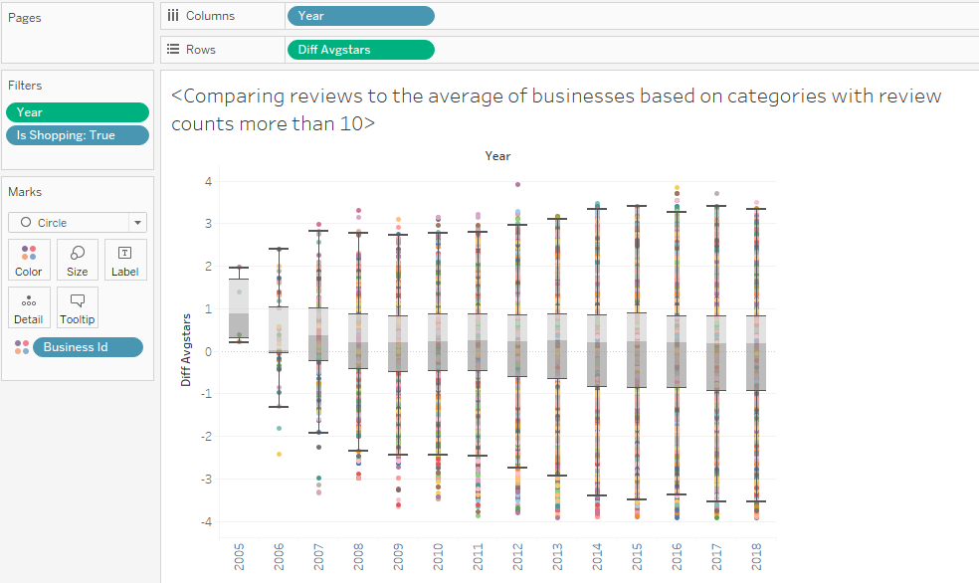
For shopping, users seem to rate the businesses slightly higher than the average

Slide 21
Category: Nightlife

Slide 22
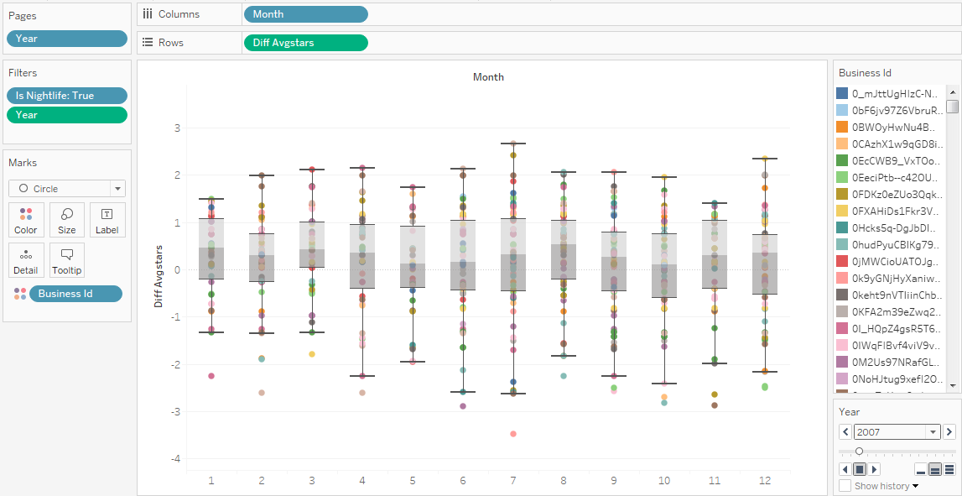
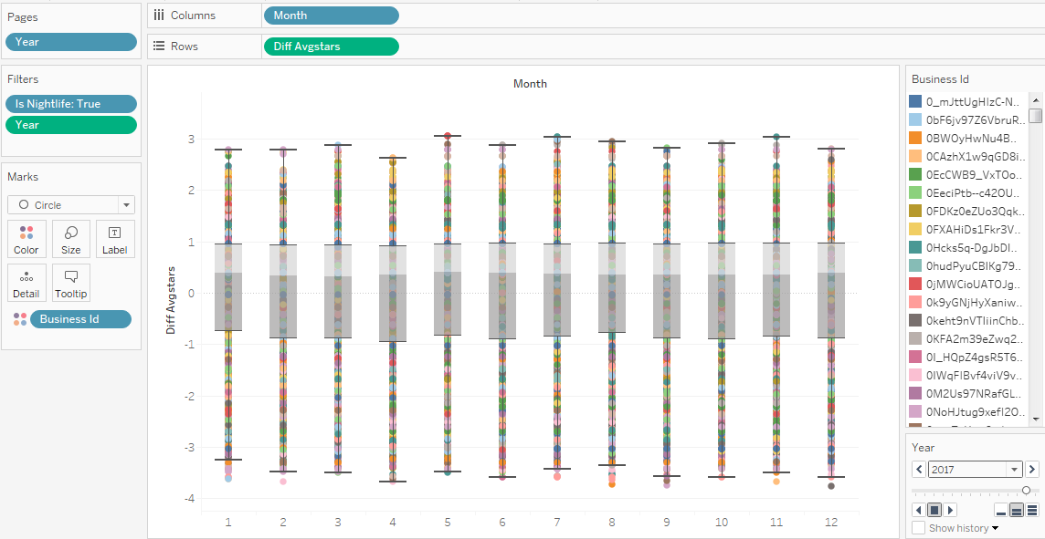
Comparison over months for 2007 vs 2017 Users rate businesses higher than the average, but no monthly pattern observed as compared to the initial years where the median was higher for certain months

Slide 23
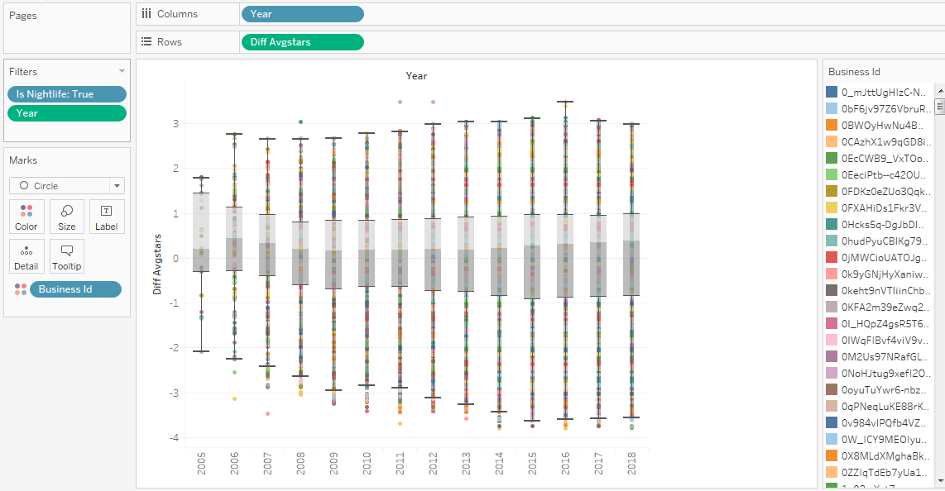
Nightlife: higher than the average: 2016 saw some businesses rated comparatively higher than the other years

Slide 24
Category: Home Services

Slide 25
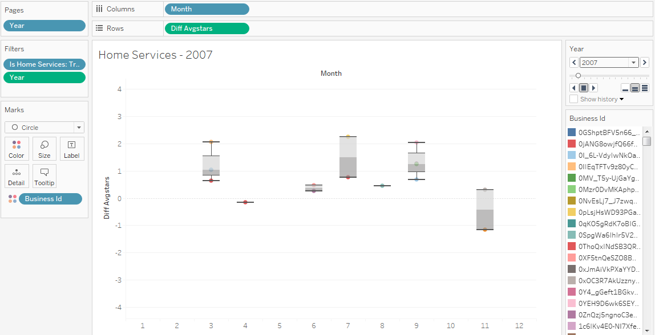
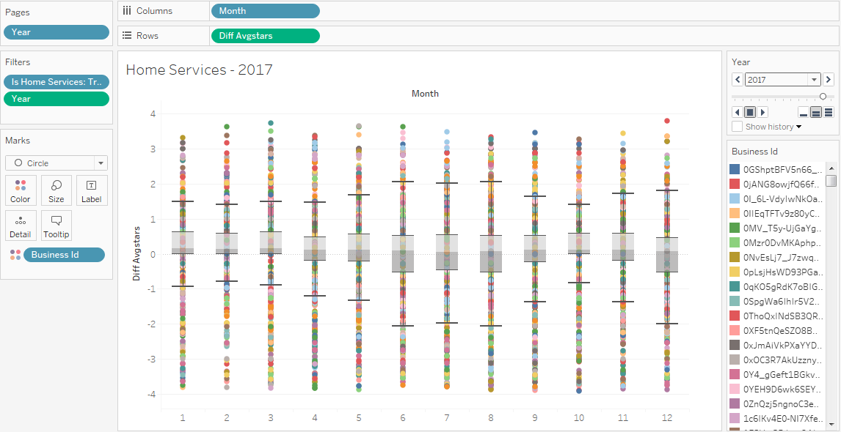
Comparison over months for 2007 vs 2017. Users hardly rated much home services businesses in the early years of Yelp. Of late, they rate it higher than the average, although the summers have a higher dispersion of ratings than the other months

Slide 26

Home Services over the years. The initial four years show random variation; the box seems to be getting narrower in the last 5 years, with user ratings getting closer to the average each year

Slide 27
Category: Arts & Entertainment

Slide 28
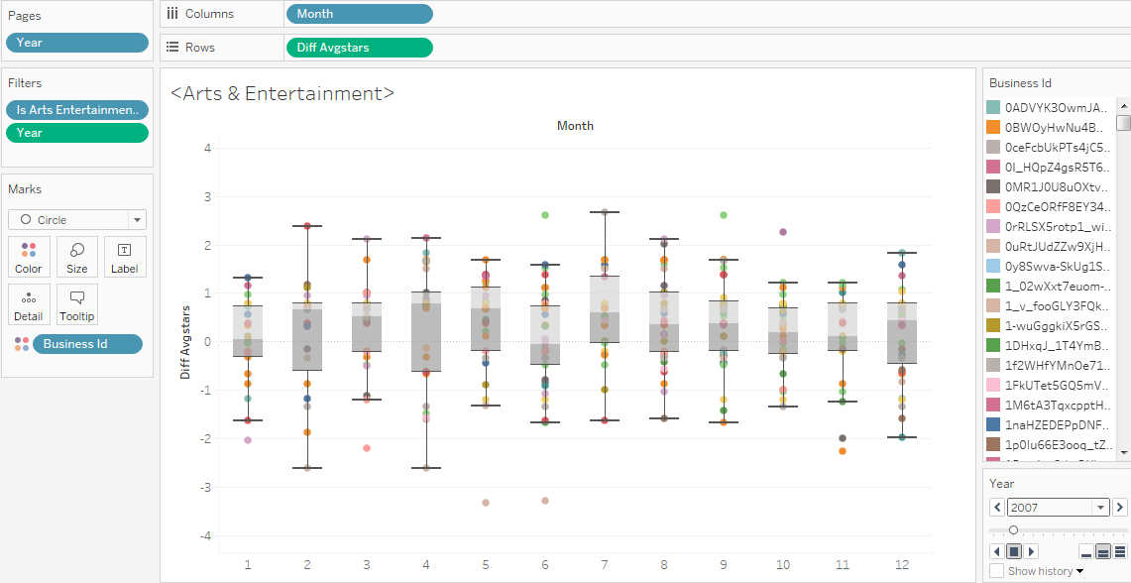
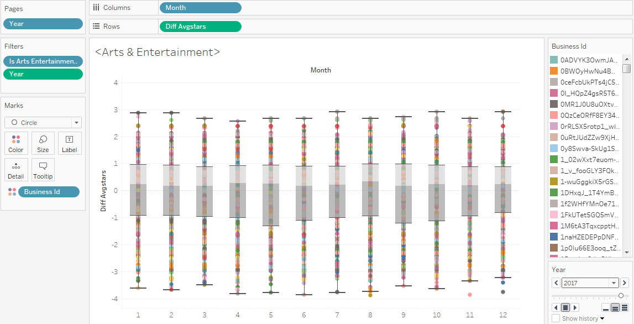
Ratings fluctuated both up and down during the initial years but evened our in the recent years. Users rate businesses higher than the average but no trend is observed over the months

Slide 29
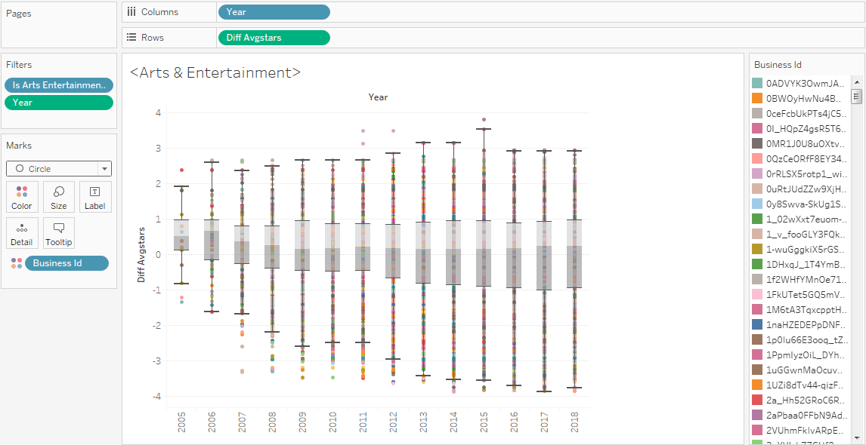
Arts & Entertainment over the years; users rate businesses higher than the average; 2015 saw a higher maximum rating than other years

Slide 30
Pattern for monthly variations in the ratings of businesses? Does this vary geographically?

Slide 31
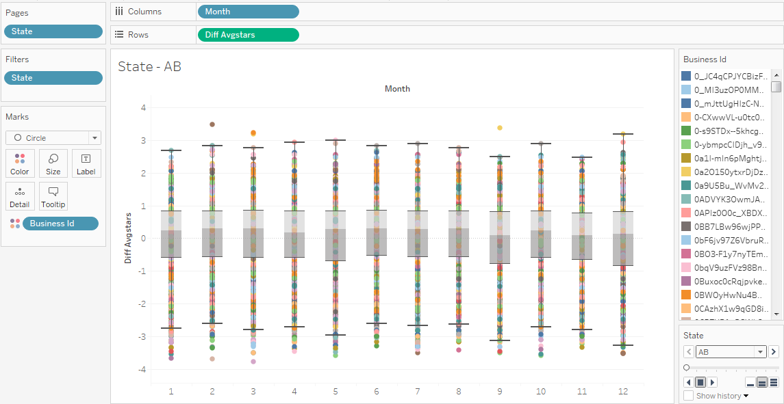
Alberta (AB): the median holds around the same value for each month but the max and min ratings are low as compared to other states

Slide 32
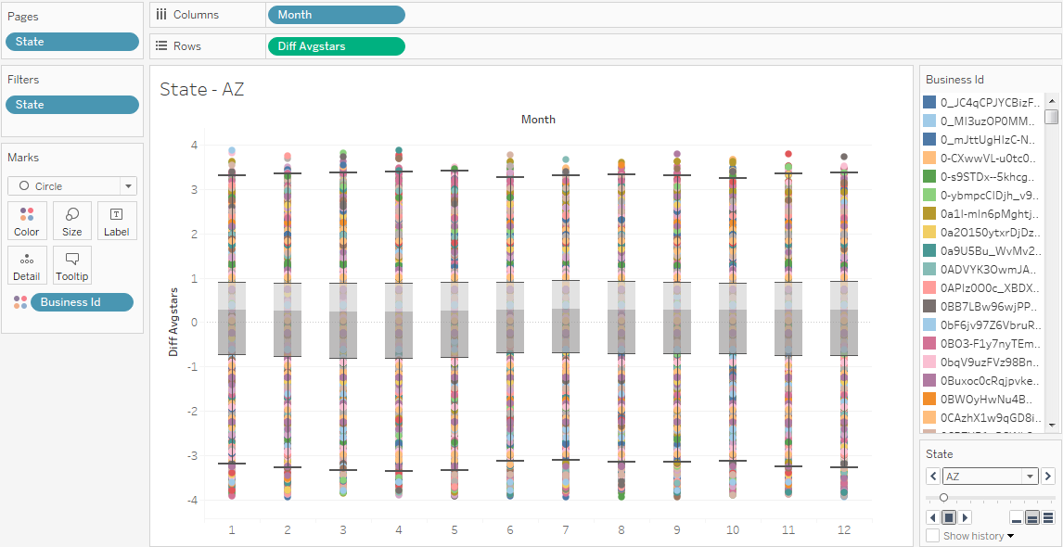
Arizona (AZ): a large number of businesses either have a lower or higher rating than the average, as compared to the other states

Slide 33
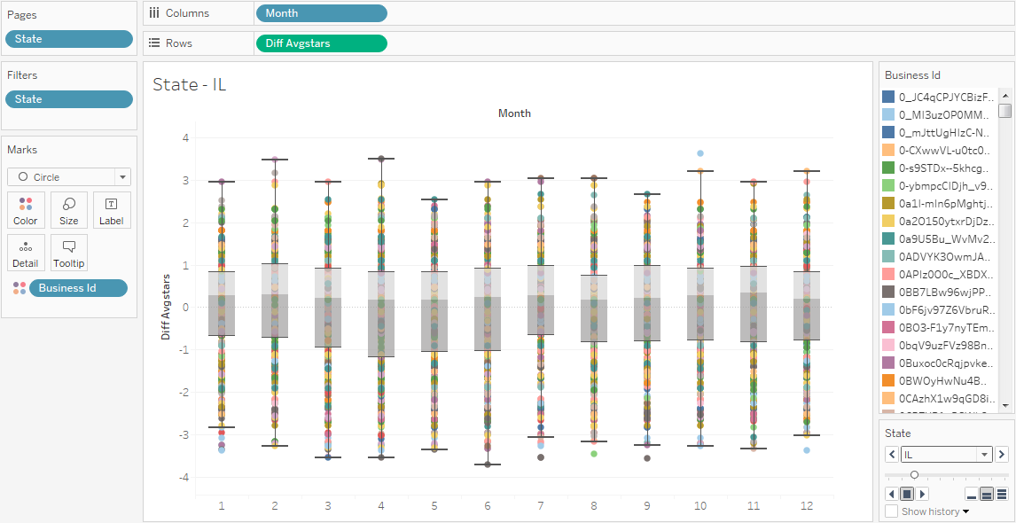
Illinois (IL): the spread for May and September is narrow; February and April have the widest variance for ratings

Slide 34
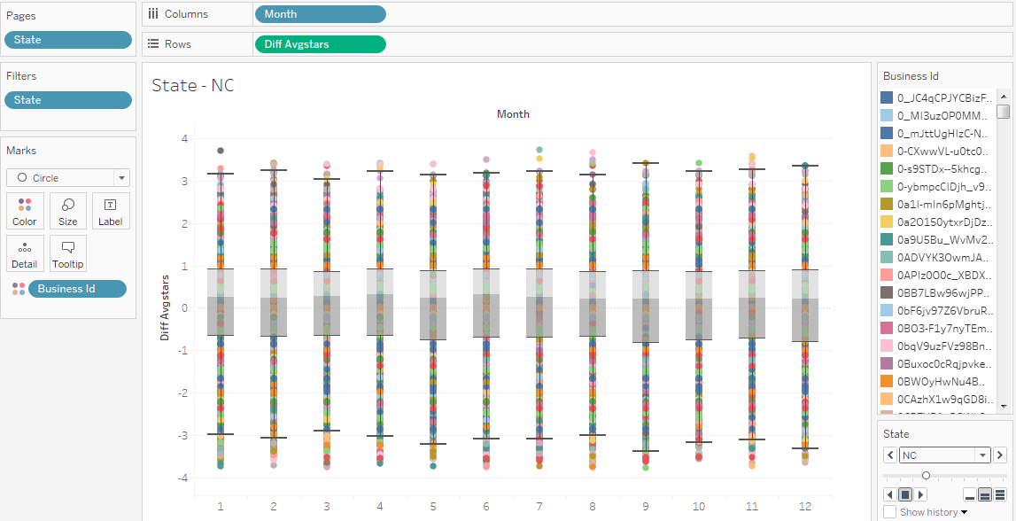
North Carolina (NC): for some reasons, we observe a lot of outliers for this state, suggesting errors (specially before the 1st quartile)

Slide 35
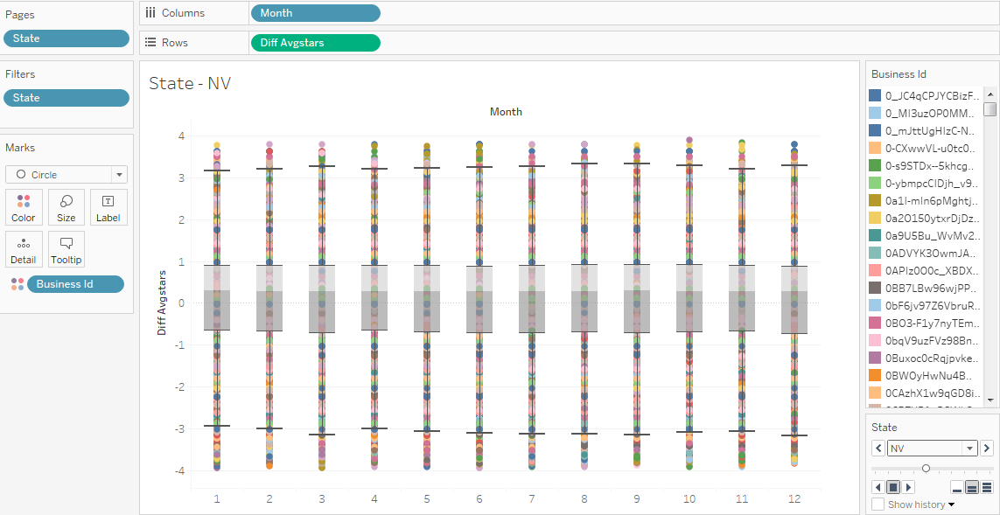
Nevada (NV): a large number of outliers; this needs to be looked into, to observe if a particular driver is behind it

Slide 36
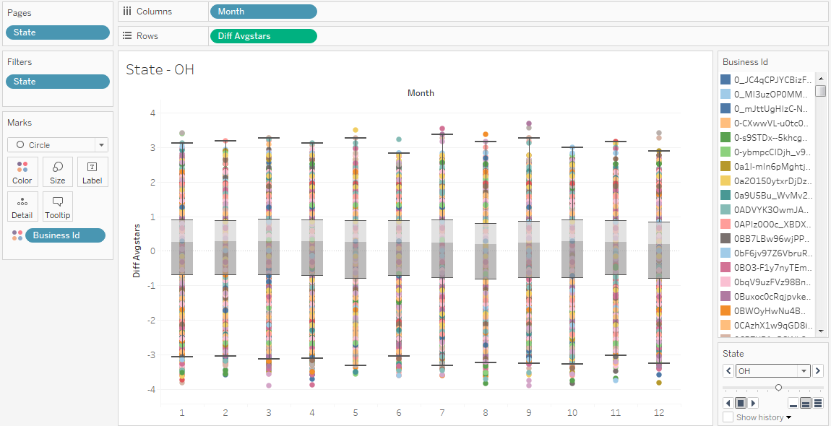
Ohio (OH): the dispersion is narrower in June, October and December, as compared to other months

Slide 37
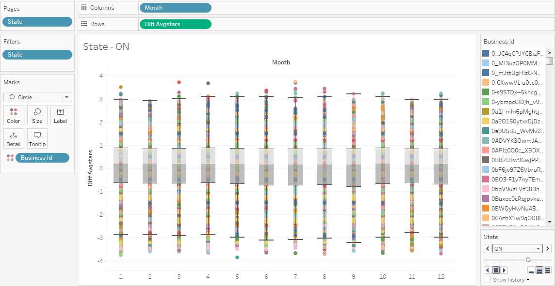
Ontario (ON): higher than average

Slide 38
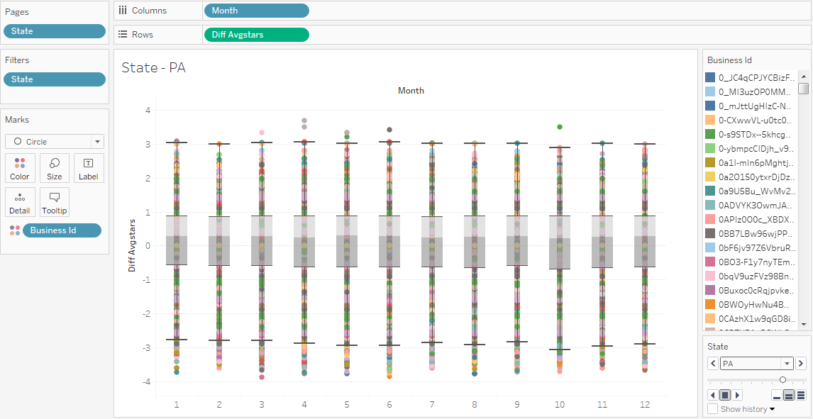
Pennsylvania (PA): no observable monthly variance in ratings which are all higher than the average

Slide 39

South Carolina (SC): of all the states, SC has the least difference from the average ratings. And they seem to variate each month too (although higher than the average)

Slide 40
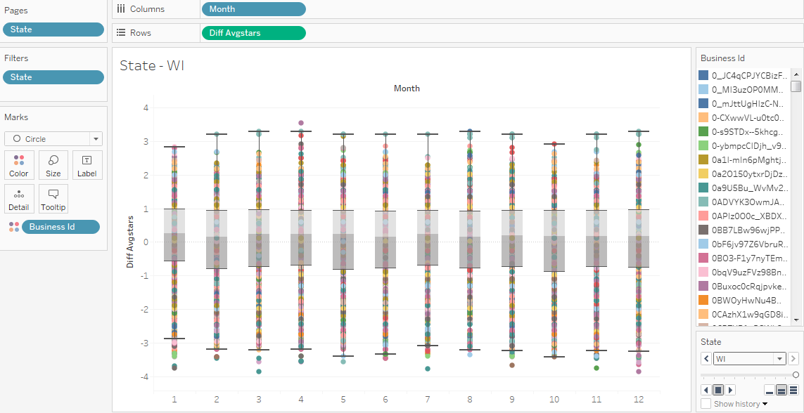
Wisconsin (WI)

Slide 41
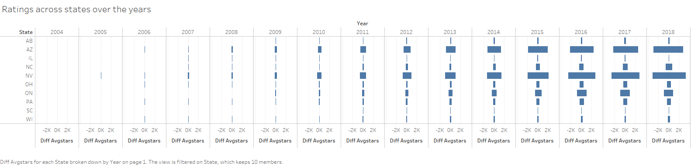
We can see here how there is not much difference in the user ratings from the average ratings in the initial years (mostly because of lack of data). However this starts to change from 2010 onwards. Arizona and Nevada have the biggest difference of the lot

Slide 42
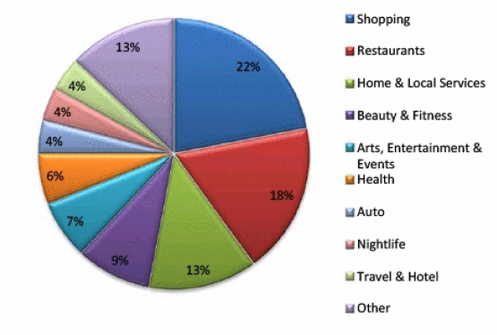
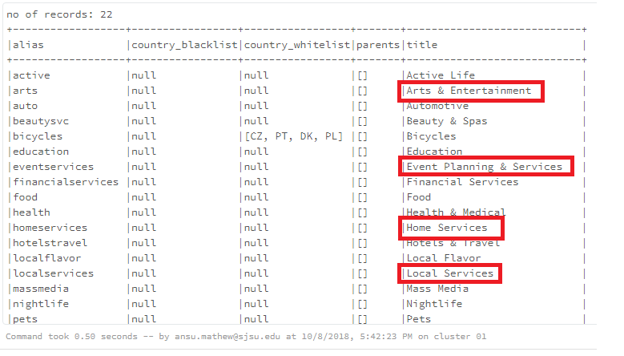
Limitation - 01
Concerns in the top-level categories selected for analysis –
We selected 5 top-level categories, Restaurants, Shopping, Home services, Arts & Entertainment and Nightlife. In the charts which showed the percentages of reviews received by the businesses, the Yelp10K document mentions Home services as Home & Local Services. During data wrangling, the categories dataset showed Home services as one top-level category and Local Services as another. Similarly Arts & Entertainment was shown to be separate from Events and Planning but in the chart, it was Arts, Events and Entertainment. We consider this as a limitation because we are not sure how it would impact our analysis.

Slide 43
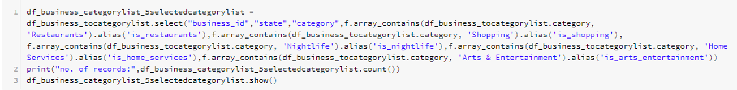
Limitation-02
Concerns over the ‘NULL’ records
While trying to answer our question based on category, we tried to bring in the business dataset, review dataset and the categories together. Using sql queries to join the 3 datasets, we got a large number of records. In order to avoid this, we used a less complex query that would help us to filter the categories based on ‘true’ or ‘false’. While trying to pull up graphs for data visualization, we saw few values showed up as ‘null’. Although we did not consider these, we believe we would need to explore more into those records to find out why they showed up as null values.

Slide 44

Limitation-03
Concentration of reviews is more for restaurants and shopping categories.
The primary reason is because of the frequency with which the individuals visit these specific categories or engage with them more than the others. Therefore comparing such businesses to those others where users visit less would limit the accuracy of the analysis.

Slide 45
We see a lot of outliers when looking at businesses over time (across states). They can be because of errors in rating or by virtue of the filters we applied. We’re limited in understanding this since there is no pattern to it. Co-incidentally, the outliers seem to lie mostly in the lower regions of the graph, for reasons we’re not exactly sure of.
Limitation-04

Slide 46

Conclusion & Takeaways
Users rate the businesses mostly higher than the average but there is no monthly trend to it.
Our project allows us to answer if the users rate businesses higher or lower than the business category, but it doesn’t tell by how much or what percentage of users rate it higher/lower. Yelp can build onto it
Using the project’s findings, the Yelp team can identify the businesses who fared lower than the average ratings. This could be either be consumer related or based on business functions across different states where seasonal fluctuations were observed

Slide 47

Questions?

Slide 48

Thank you!

